Slide 1

Macroeconomics II
Lecture 12
Inequality, measures
The Kalecki model

Slide 2
Theoretical Lecture 11
Inequality and Income Distribution
personal income distribution: forms of representation;
Lorenz curve; Gini index (concentration; inequality?); S80/S20 and S90/S10;
relations of economic growth with income distribution: major topics;
political power, efficiency and distribution;
a dynamic framework of institutions;
Gender inequality
The Kalecki model
Readings:
Louçã and Mortágua (2021), chapter 8
Data in: World Inequality Database, online

Slide 3
Inequality – debates
What is inequality
  Social diferentiation
  Income inequality – distribution
  Inequality with respect to control of the main means of production and, therefore, with respect to labour relations and control of the product of labour
Inequality related to social forms of organization of production and control, appropriation and utilization of surplus
Inequality based on segregation and diferences in opportunities and outcomes
Specific social forms of inequality: class, gender, race, religion, etc.

Slide 4
Inequality – debates
What causes it?
  Profit driven – capital accumulation and concentration of capital and wealth; markup prices by top firms (realization rather than generation of profit; but helps large firms, inlcuding banks, to dominate markets)
  Wage driven – demand and distribution
  Social costs of subsistance and the real wage (purchasing power linked with the relative price inflation of wage goods)
  Class and gender, as well as race/ethnicity, religion and others as forms that class and gender inequality may take in specific historial contexts

Slide 5
Inequality is an old story

Slide 6
Ups and downs in the 20th and 21st centuries

Slide 7
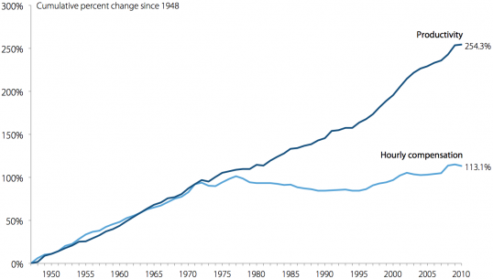
Labour productivity vs labour compensation

Slide 8
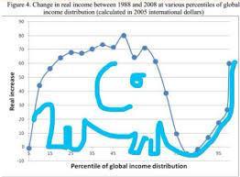
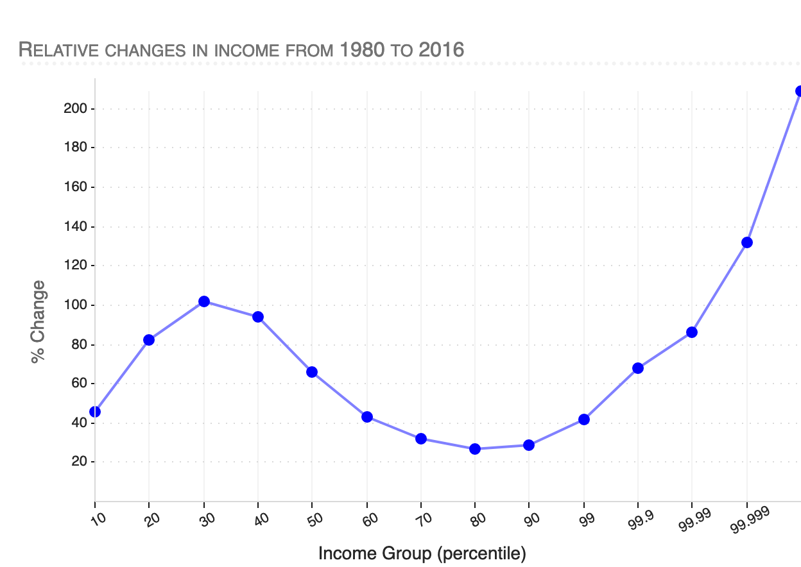
The “elephant” of Branko Milosevic

Slide 9
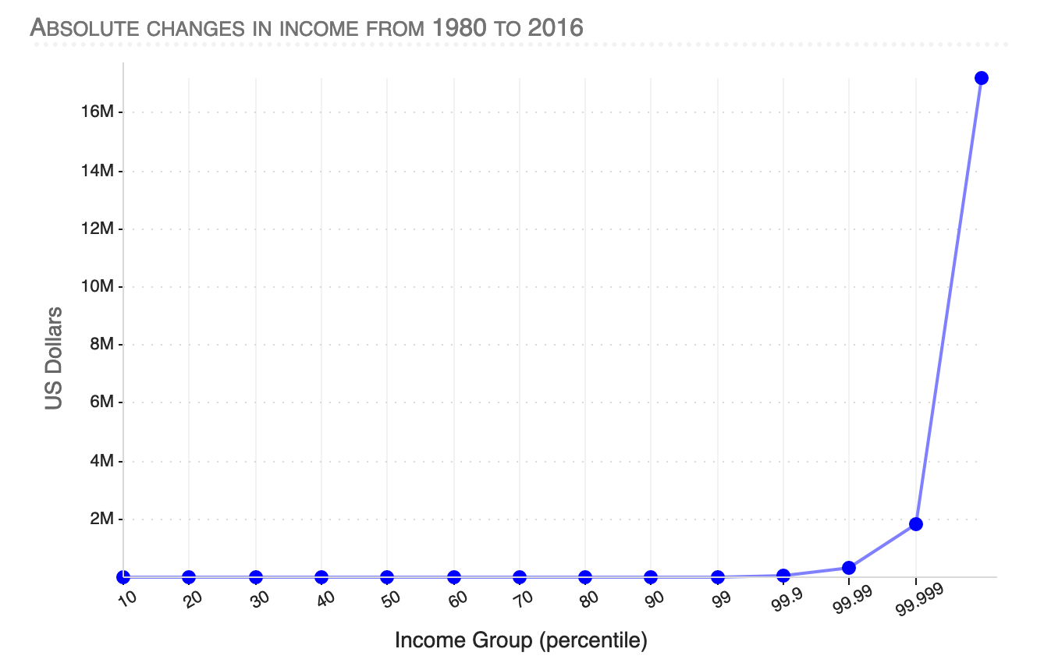

Slide 12
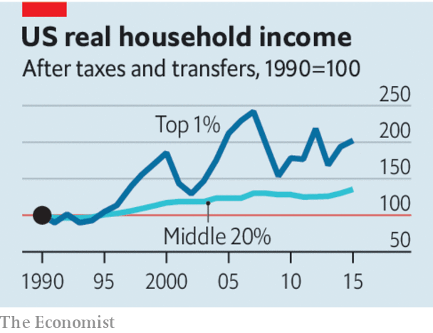
Inequality in the US
Notes:
12

Slide 13
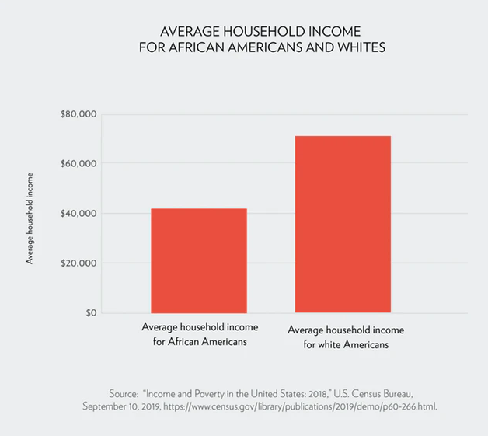

Slide 14
A future of inequality?
14
Notes:
14

Slide 15
Personal income distribution: forms of representation
for a given year, how is total disposable income in a country distributed among all the population (individuals, or households) of that country?
two different procedures:
method 1: to divide the population into several equal-sized groups (equal population shares) and to measure how much each income group earns/share of total household income; ex: quintiles, deciles, etc (relevant to compare population shares and income shares: a step towards the “evaluation” of inequality;
method 2: to divide income into equal-sized intervals and to ask how much of the population falls into each interval/share of total population (relevant to fit a distribution function: typically a lognormal, and to estimate mean and standard deviation, the parameters of this distribution function);
let us look at them …

Slide 16
method 1:
to divide the population into several equal-sized groups and to measure how much each
income group earns/share of total household income; ex: quintiles, deciles, etc
Household Income in the United States by Quintiles, 2009

Slide 17
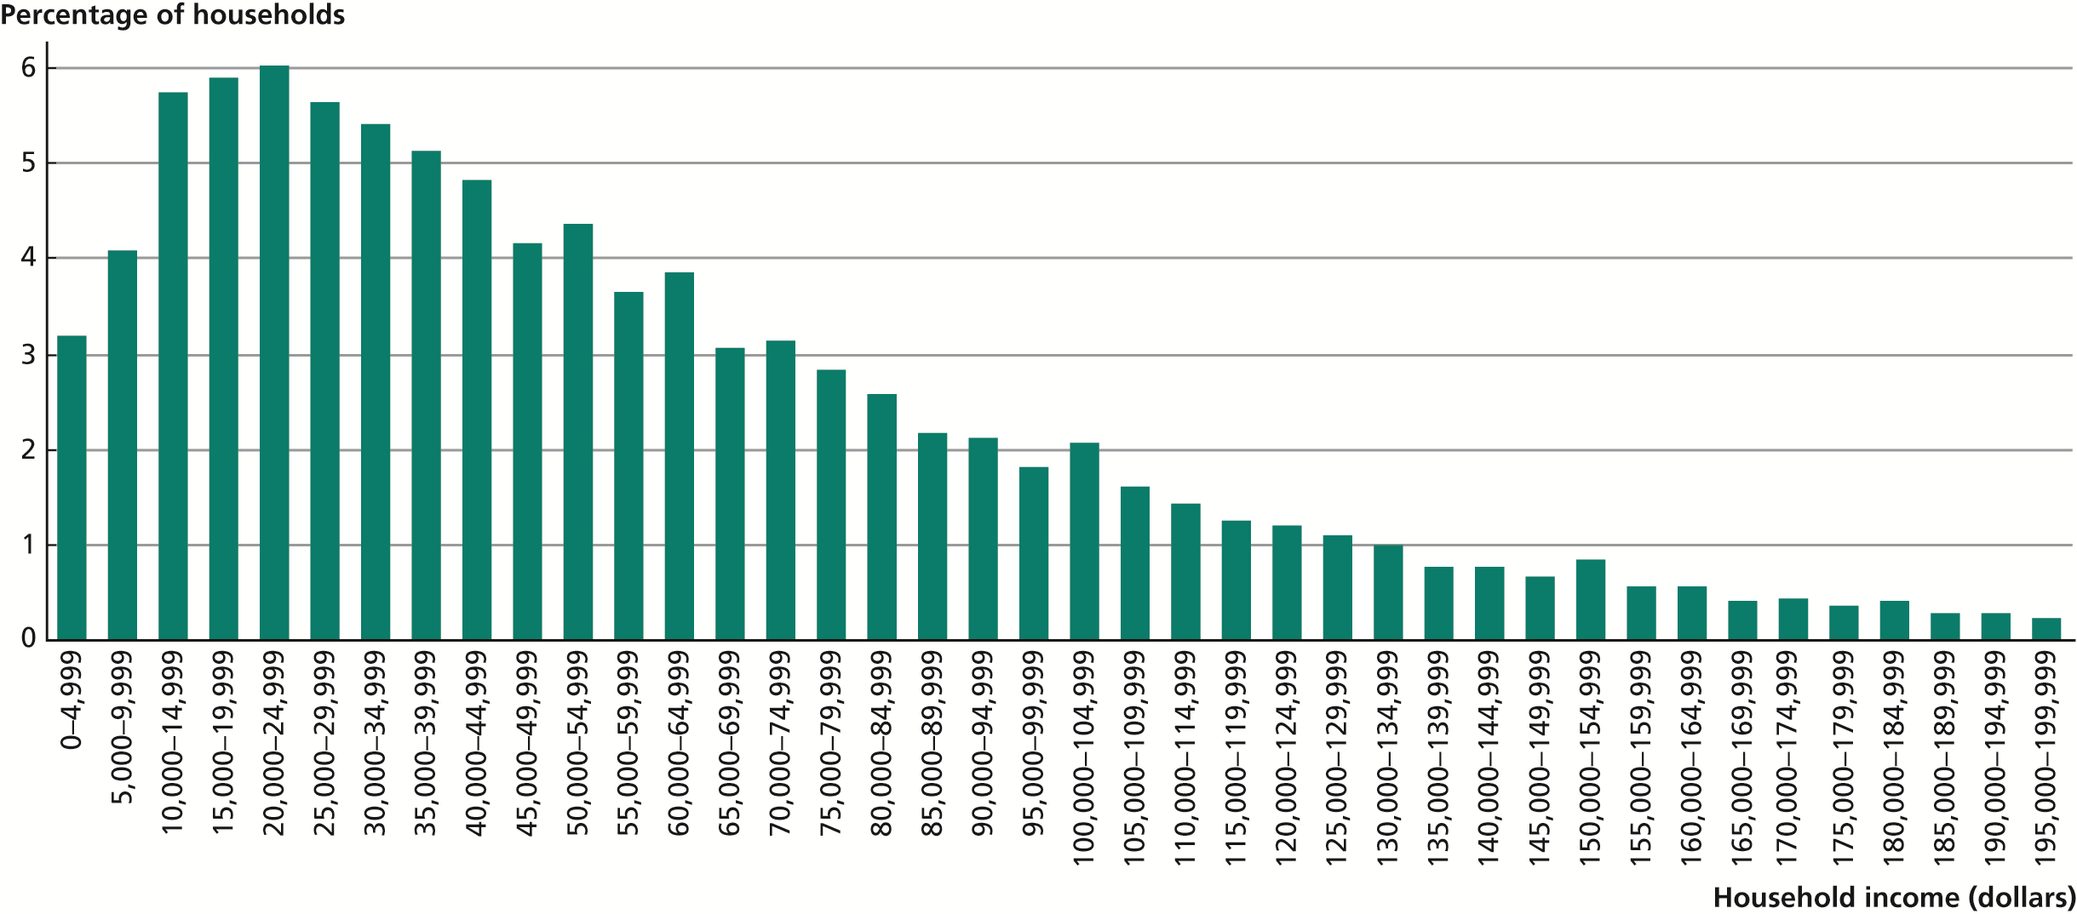
to divide income into equal-sized intervals
and to ask how much of the population
falls into each interval/share of total population
method 2:
Income Distribution in the United States, 2009
mean = $ 67,976
median = $ 49,777
mode = ($ 20,000 – $ 24,999)
Source: DeNavas-Walt, Proctor, and Smith (2010).

Slide 18
from income distribution
to the inequality of income distribution
from a descriptive (what it is) to a normative approach (what it should be) to
income distribution
only makes sense to assess inequality of personal income distribution;
an income distribution is unequal if the differences of income among the individuals/households are greater than what is desirable according to the set of values of that person who evaluates the inequality;
different forms of introducing normative principles into the assessment of income inequality; one of them consists of comparing population shares and income shares (from method 1):
Lorenz/Gini method;
S80/S20 or S90/S10 methods;

Slide 19
The Lorenz curve
Variable X (income) observed on a population of size n
let xi be the income of person i of that population
(x1, …, xi, …, xn)
and x1 ≤ … xi ≤ … ≤ xn ; and let xtot be the total income of that population
we create two variables: Y and Z. Then, for the person i:
xi income of person i
yi proportion of persons with income ≤ xi
zi proportion of total income, xtot of the persons with income ≤ xi
let Z = z(Y) → Lorenz curve of the concentration of variable X

Slide 20
Gini index G = (0AZ)/(01Z)
0,0 ≤ G ≤ 1,0
concentration = inequality?

Slide 21
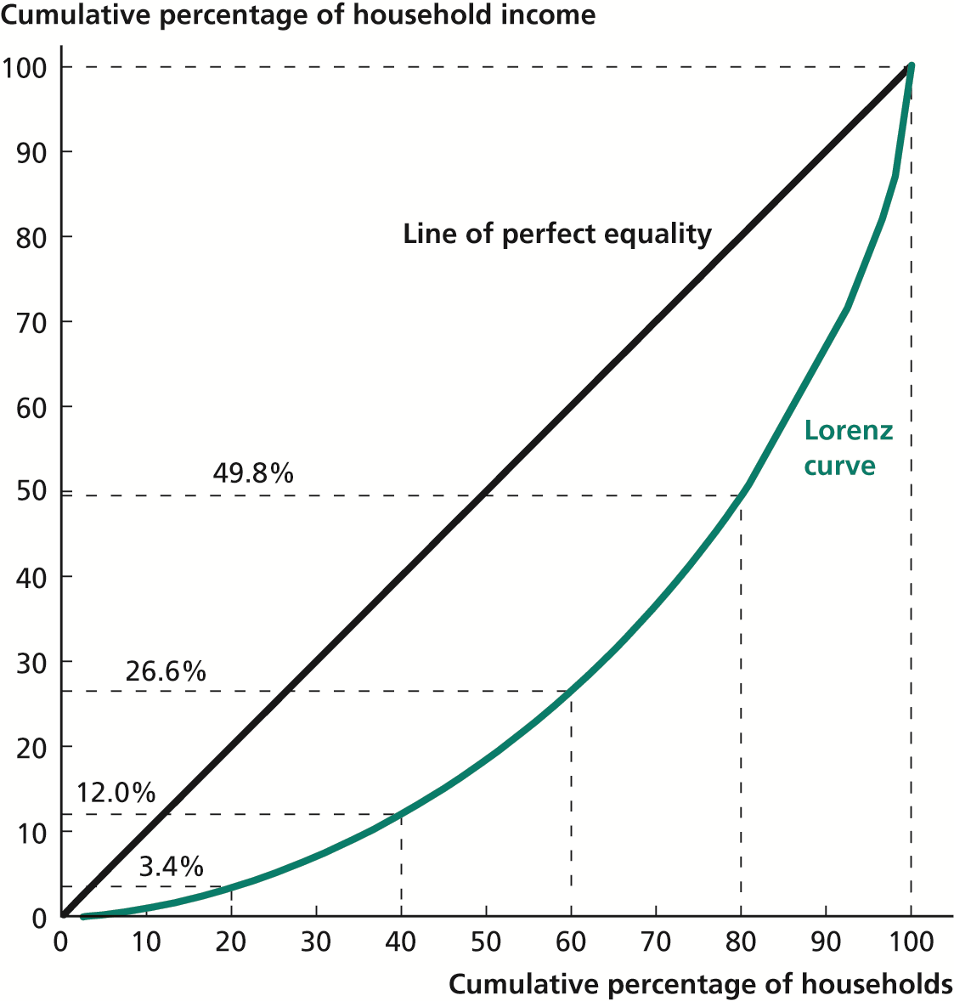
The Lorenz Curve for the United States, 2009
Source: De Navas-Walt, Proctor, and Smith (2010).

Slide 22
Gini index (concentration; inequality?) and S80/S20 or S90/S10
Portugal
2009 2010 2011 2012 2014 2016
Gini 0,337 0,342 0,345 0,342 0,339 0,335
S80/S20 5,6 5,7 5,8 6,0 5,9 5,7
S90/S10 9,2 9,4 10,0 10,7 10,1 10
Source: EU-SILC

Slide 24
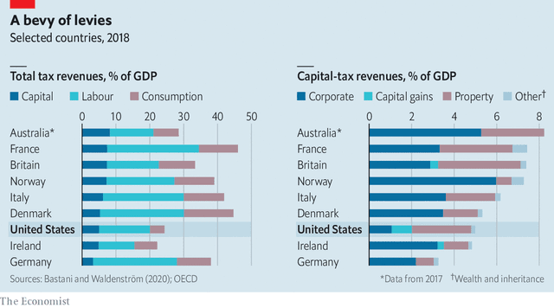
Does power increase inequality?
The example of the tax system

Slide 25
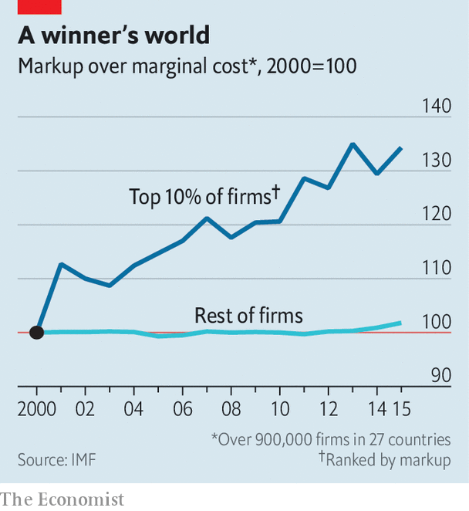
yes, there is a mark up by the 10% top firms

